Slide 1
EXECUTIVE REPORT | SNAKE & LADDER
Executive Summary
79.9
Expected turns from square 1
100
Board squares
9
Ladders
9
Snakes
METHOD
The board is modeled as an absorbing Markov chain, with the transition matrix built directly from the board layout and a 1-dice roll distribution -- not a fixed spreadsheet.
The fundamental matrix N = (I - Q)^-1 gives the expected number of turns to finish from every square at once.
Because the matrix is built in code, the same analysis re-runs for any dice count -- see the dice-count comparison on the final slide.
Absorbing Markov Chain | Fundamental Matrix Analysis
01/05

Slide 2
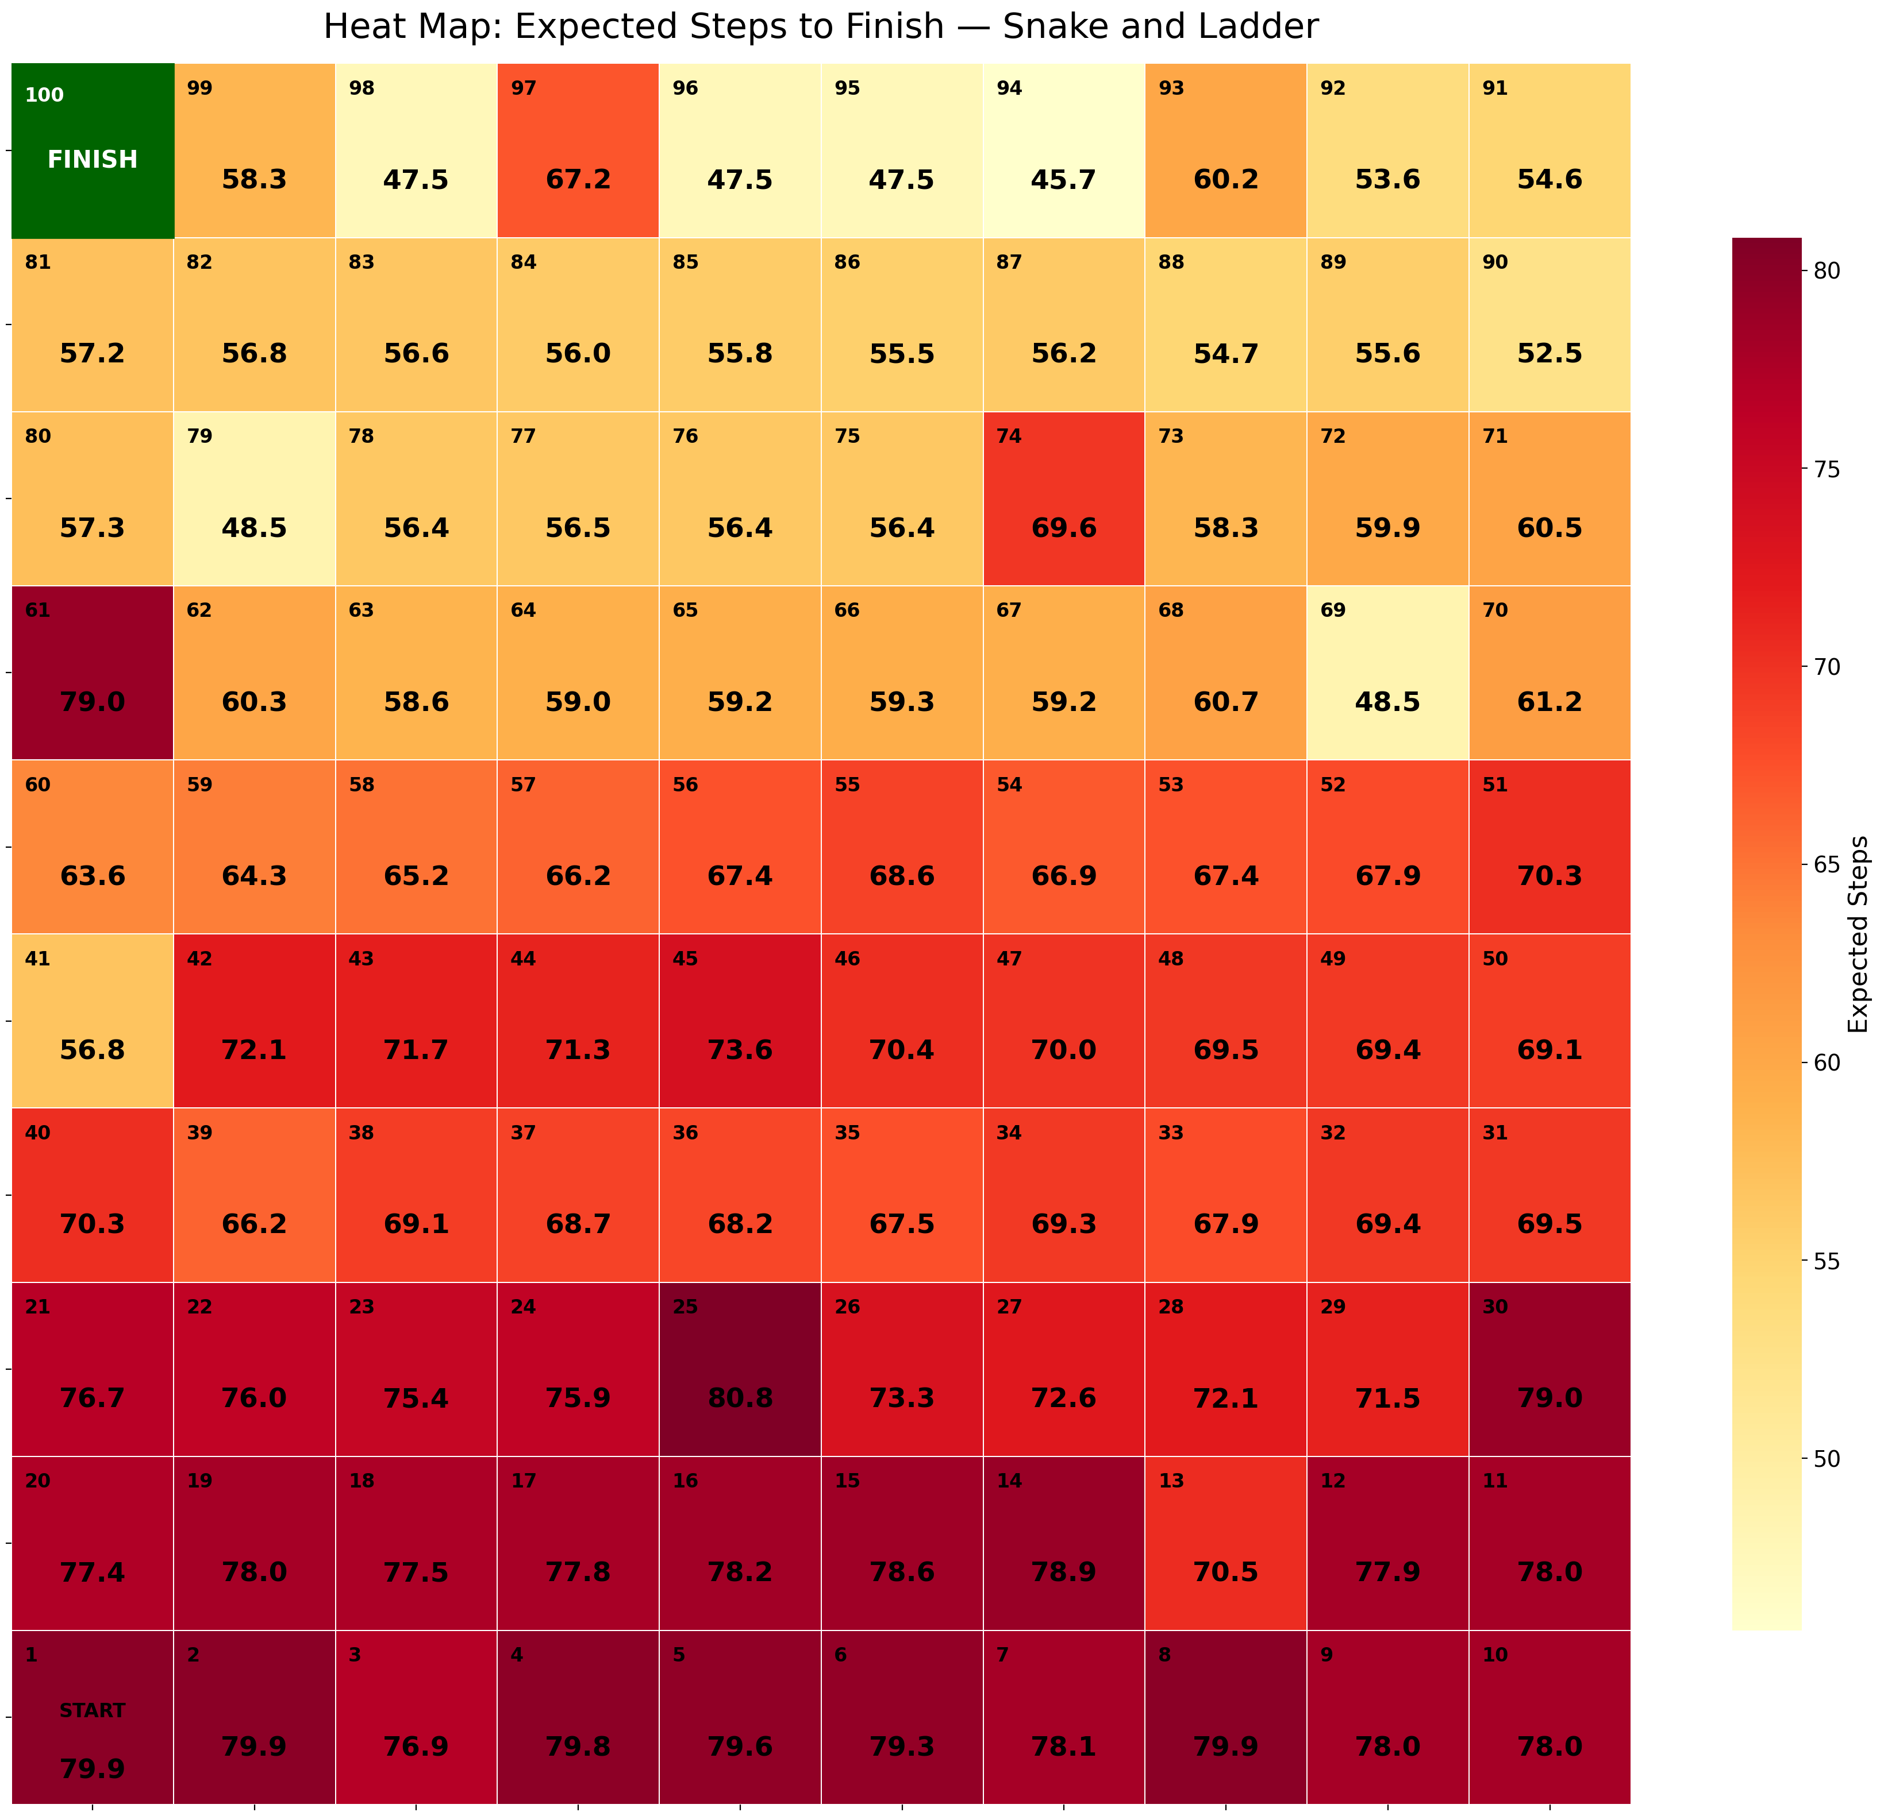
EXECUTIVE REPORT | SNAKE & LADDER
Board Heatmap
EXPECTED STEPS TO FINISH, BY SQUARE
Absorbing Markov Chain | Fundamental Matrix Analysis
02/05

Slide 3
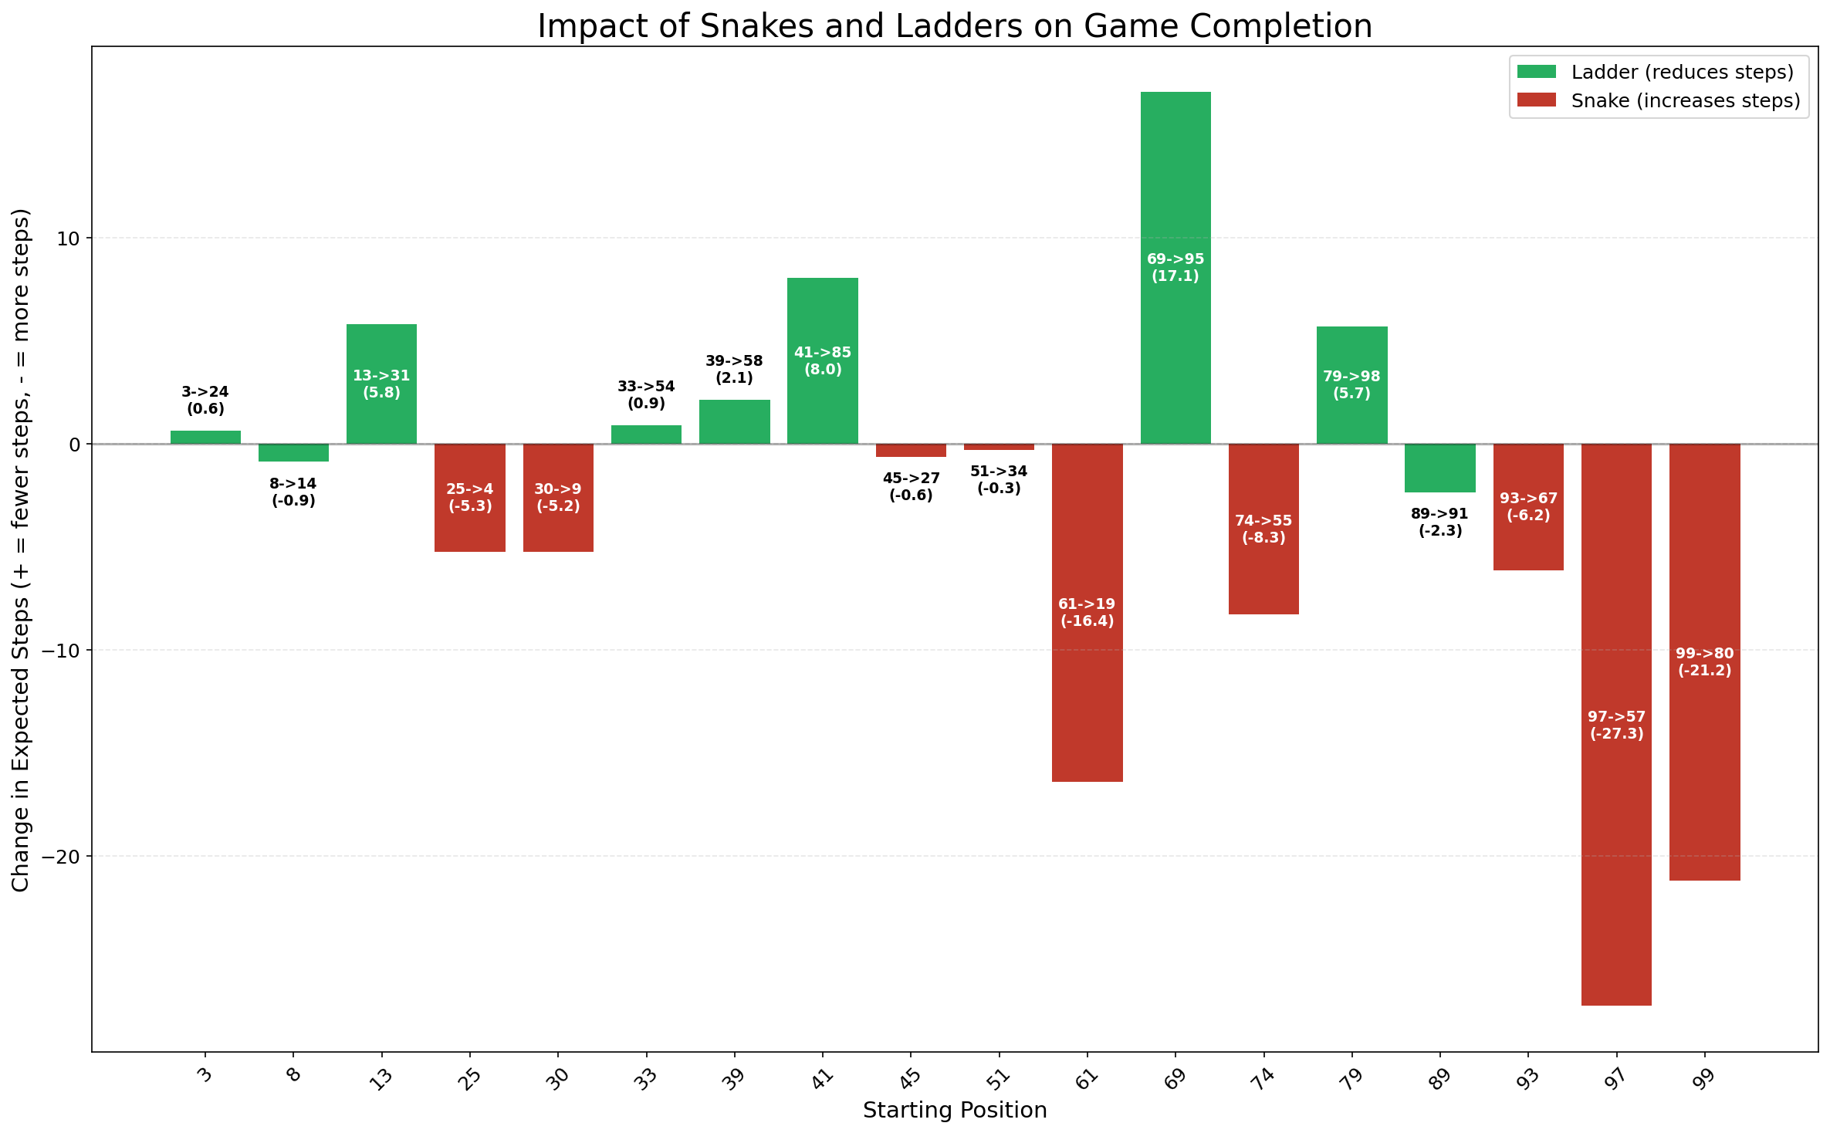
EXECUTIVE REPORT | SNAKE & LADDER
Snake & Ladder Impact
HOW MANY TURNS EACH ELEMENT SAVES OR COSTS
Biggest impact: Snake 97->57: adds 27.30 steps
Absorbing Markov Chain | Fundamental Matrix Analysis
03/05

Slide 4
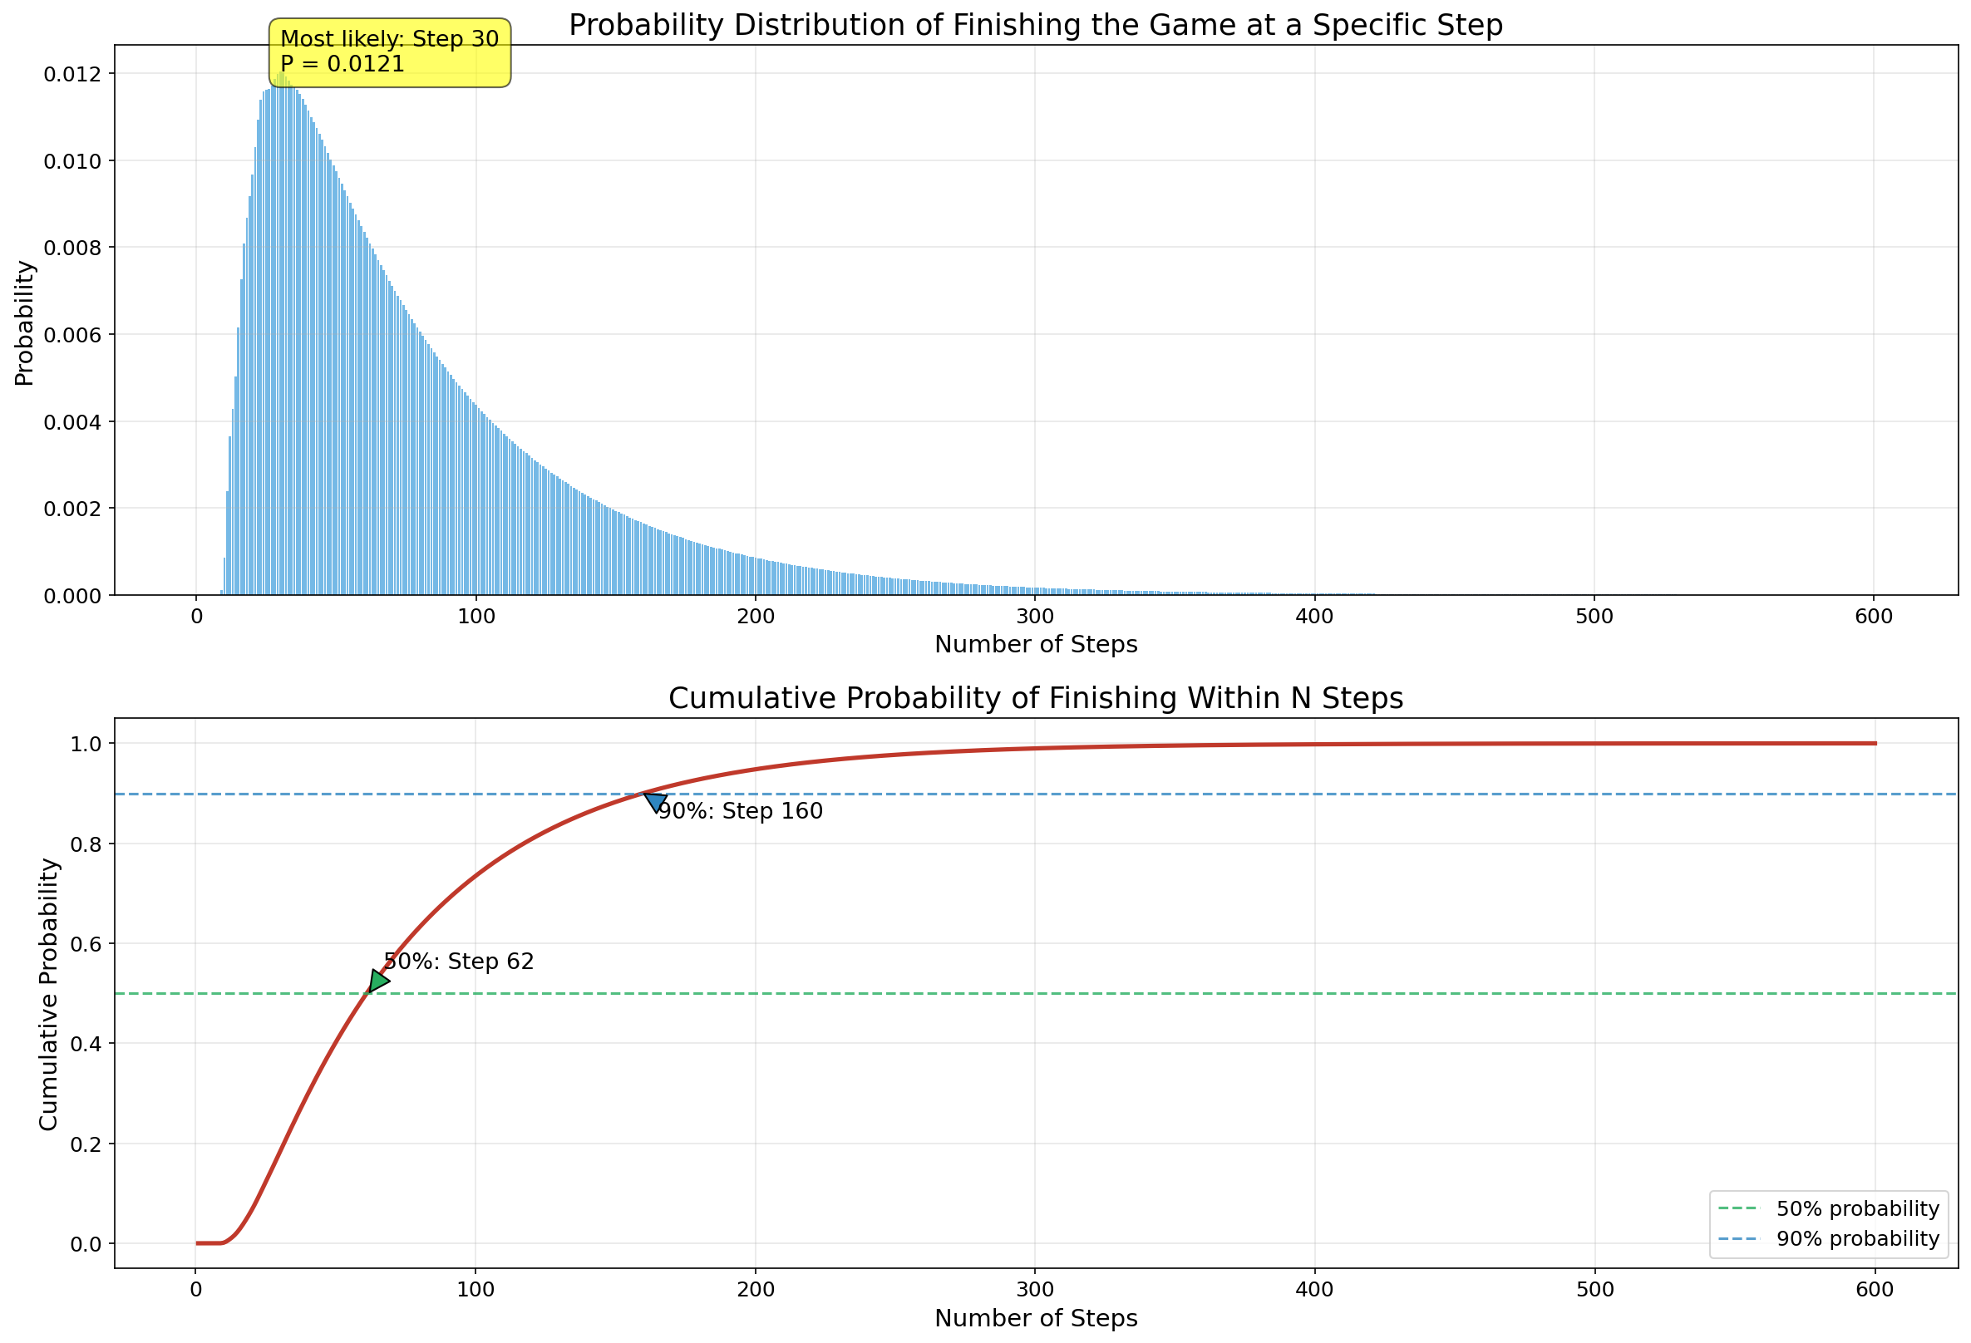
EXECUTIVE REPORT | SNAKE & LADDER
Finish-Time Distribution
WHEN DOES THE GAME ACTUALLY END?
PERCENTILES
62
Median (50%) turns
160
90th percentile turns
79.9
Mean turns
61.9
Std. deviation
Absorbing Markov Chain | Fundamental Matrix Analysis
04/05

Slide 5
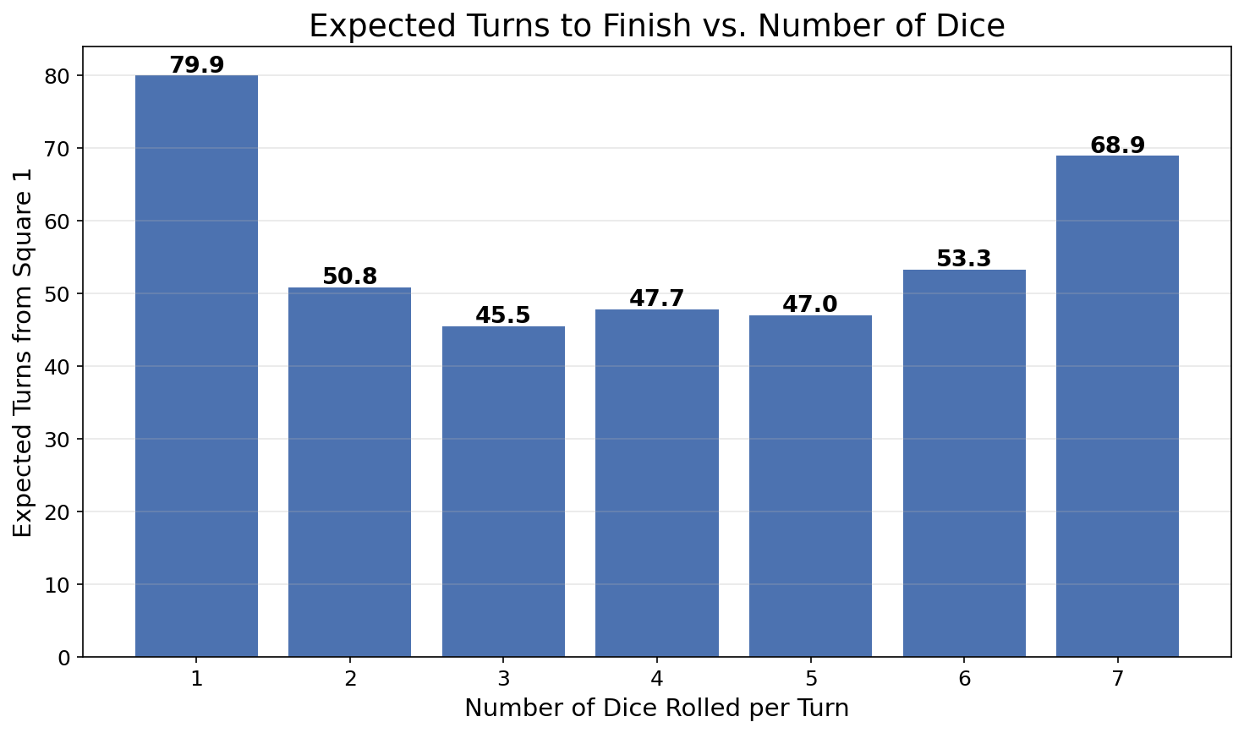
EXECUTIVE REPORT | SNAKE & LADDER
Dice Count Comparison
HOW THE NUMBER OF DICE CHANGES GAME LENGTH
Absorbing Markov Chain | Fundamental Matrix Analysis
05/05

